Slide 1
OCP Chapter 17
Roger Janssen
CodeBoosters

Slide 2

Introduction
Modules (Continued)

Slide 3

OCP CH17 Modules
Recap definition of a Java Module
A group of one or more packages including a module-info.java file.

Slide 4
OCP CH17 Modules
Recap module-info.java
must be in the root directory of your module
regular java classes should be in packages
the module name follows the naming rules for package names (like no dashes)
Notes:
Demo : place into /com and see what happens in IDE

Slide 5
OCP CH17 Modules
Recap keywords for module-info file
exports <package name>: exposes a package to other modules
exports <package name> to <module>: exposes a package to a specific module only
requires [transitive] <module name>: adds a dependency upon another module
Notes:
Covered in chapter 11.

Slide 6
OCP CH17 Modules
Recap keywords for module-info file
provides <interface> with <implementation> : specifies that a class provides an implementation of a service interface
uses <interface>: specifies that a module is relying on a service
opens : opens a package for reflection
Notes:
Covered in this chapter!

Slide 7
OCP CH17 Modules
Recap other stuff
remember to learn the command line tools with their arguments

Slide 8
OCP CH17 Modules
Module Types
Named module : a (proper) java module
Automatic module : a regular jar on the module path
Unnamed module : a regular jar on the class path
Notes:
Named module: a module containing a module-info file.
Automatic module: a regular jar without a module-info file but placed on the module path.
- treated as if there were a module-info file
- all packages are exported
- automatic module name determination
- remove the file extension from the JAR name.
- remove any version information from the end of the name. A version is digits and dots with possible extra information at the end, for example, ‐1.0.0 or ‐1.0‐RC.
- replace any remaining characters other than letters and numbers with dots.
- replace any sequences of dots with a single dot.
- remove the dot if it is the first or last character of the result.
Unnamed modele : a regular jar without a module-info file but placed on the class path.
- it doesn't export any packaged to named/automatic modules
- it can read from any JAR on the class AND module path : the reason why all non-modular code runs on java9+

Slide 9
OCP CH17 Modules
Named module
A (proper) java module, with module-info file deployed on the module path.
Module name is in the module-info file.

Slide 10
OCP CH17 Modules
Automatic module
A regular jar – no module-info file – that gets deployed on the module path.
Treated as if there was a module-info file
Module name will be determined bij the JVM.
All packages are exported.
Automatically requires all modules.

Slide 11
OCP CH17 Modules
Unnamed module
A regular jar without a module-info file and placed on the class path.
- It doesn't export any packages to named/automatic modules.
- It reads from any JAR on the class AND module path.
Notes:
It can access all classes in all jars in the module path. Non of the names modules can access any class form an unnamed module.

Slide 12
OCP CH17 Modules
Question
What happens if an unnamed module has a module-info file?
Answer
It will be ignored.
Notes:
This implies we had a proper java module packaged in a jar but deployed it on the classpath. It can be access by other classes on the class patha and will be hidden for named modules.

Slide 13
OCP CH17 Modules
Question
A(n) _____________ module is on the classpath while a(n) _____________ module is on the module path. (Choose all that apply.)
1. automatic, named
2. automatic, unnamed
3. named, automatic
4. named, unnamed
5. unnamed, automatic
6. unnamed, named
7. None of the above
Answer: 5, 6

Slide 14
OCP CH17 Modules
Question
Does an automatic module have a module-info file?
Answer
No. A named module does. An unnamed module may have such a file but it will be ignored!

Slide 15
OCP CH17 Modules
Question
Is an unnamed module readable by other modules on the module path?
Answer
No. An unnamed module is on the class path! Only named and automatic modules are accessible from the module path!

Slide 16
OCP CH17 Modules
Question
Which are true statements? (Choose all that apply.)
An automatic module exports all packages to named modules.
An automatic module exports only the specified packages to named modules.
An automatic module exports no packages to named modules.
An unnamed module exports only the named packages to named modules.
An unnamed module exports all packages to named modules.
An unnamed module exports no packages to named modules.
Answer: 1, 6
Notes:
1, 6. An automatic module exports all packages, making option 1 correct. An unnamed module is not available to any modules on the module path. Therefore, it doesn't export any packages, and option 6 is correct.

Slide 17
OCP CH17 Modules
Automatic module name determination algorithm
Note that a JAR has a MANIFEST.MF file that may define the property Automatic-Module-Name.
Manifest-Version: 1.0 Archiver-Version: Plexus Archiver Created-By: Apache Maven Built-By: adfu Build-Jdk: 11.0.9.1 Automatic-Module-Name: com.google.guice
Notes:
Example from the guice library from google.

Slide 18
OCP CH17 Modules
Automatic module name determination algorithm
If the manifest file specifies the module name use that
Otherwise remove the file extension from the JAR name
remove any version information from the end of the name
replace any remaining characters other than letters and numbers with dots
replace any sequences of dots with a single dot
remove the dot if it is the first or last character of the result.
Notes:
A version is digits and dots with possible extra information at the end, for example, ‐1.0.0 or ‐1.0‐RC.

Slide 19
OCP CH17 Modules
Example module name determination
 | Description | Example 1 | Example 2
1 | JAR name | commons2‐x‐1.0.0‐SNAPSHOT.jar | mod_$‐1.0.jar
2 | Remove file extension | commons2‐x‐1.0.0‐SNAPSHOT | mod_$‐1.0
3 | Remove version information | commons2‐x | mod_$
4 | Replace special characters | commons2.x | mod..
5 | Replace sequence of dots | commons2.x | mod.
6 | Remove leading trailing dots | commons2.x | mod

Slide 20
OCP CH17 Modules
Question
Which of the following JAR filename and generated automatic module name pairs are correct? (Choose all that apply.)
1. emily‐1.0.0.jar and emily
2. emily‐1.0.0‐SNAPSHOT.jar and emily
3. emily_the_cat‐1.0.0.jar and emily‐the‐cat
4. emily_the_cat‐1.0.0.jar and emily_the_cat
5. emily.$.jar and emily..
6. emily.$.jar and emily
7. emily.$.jar and emily.
Answer: 1, 2, 6
Notes:
Any version information at the end of the JAR filename is removed, making options 1 and 2 correct. Underscores (_) are turned into dots (.), making option 3 and 3 incorrect. Other special characters like a dollar sign ($) are also turned into dots. However, adjacent dots are merged, and leading/trailing dots are removed. Therefore, option 5 is correct.

Slide 21
OCP CH17 Modules
Migrating non modular applications
Bottom up
Create dependency graph of the packages / libs
Start with the package/lib that has no dependencies
Add module-info (with exports, requires)
Move to the module path
Repeat from 2
Notes:
This approach works best when you have the power to convert any JAR files that aren't already modules.

Slide 22
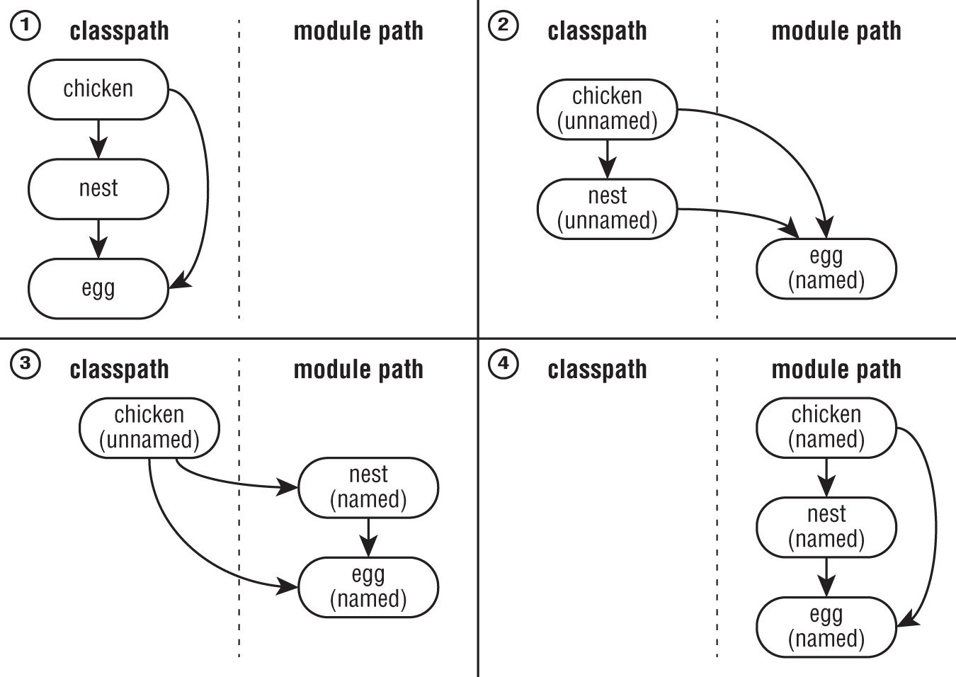
OCP CH17 Modules

Slide 23
OCP CH17 Modules
Top down
Create dependency graph of the packages / libs
Put all packages / libs on the module path
Select the highest level that has not yet been migrated
Add module-info (with exports, requires)
use the automatic derived names for the required modules
Repeat from 3
Notes:
A top‐down migration strategy is most useful when you don't have control of every JAR file used by your application.

Slide 24
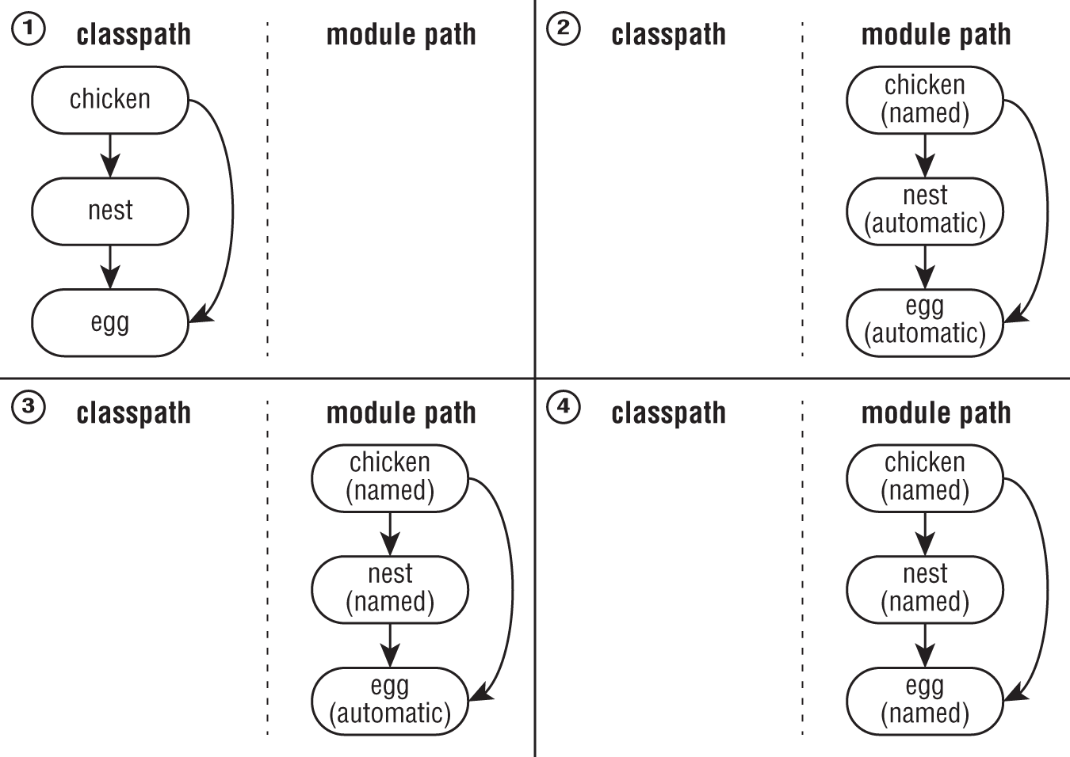
OCP CH17 Modules

Slide 25
OCP CH17 Modules
Migration strategies compared
Bottom up : when your are in control of all libs/jars.
Top down : when you are not in control of all libs/jars.

Slide 26
OCP CH17 Modules
Question
For a top‐down migration, all modules other than named modules are ____________ modules and on the ____________.
1. automatic, classpath
2. automatic, module path
3. unnamed, classpath
4. unnamed, module path
5. None of the above
Answer: 2
Notes:
A top-down migration strategy first places all JARs on the module path. Then it migrates the top-level module to be a named module, leaving the other modules as automatic modules. Option 2 is correct as it matches both of those characteristics.

Slide 27
OCP CH17 Modules
Services
Consist of:
an interface / abstract class decribing the service
any classes the interface references
some method of looking up implementations of the service
Note that implementations are not part of the service!

Slide 28
OCP CH17 Modules
Services
Artifact | Part of service? | Directives required
Service provider interface | Yes | exports
Service provider | No | requires, provides
Service locator | Yes | exports, requires, uses
Consumer | No | requires
Important methods of the ServiceLoader (for the exam):
public static <S> ServiceLoader<S> load(Class<S> service) { … }
public Stream<Provider<S>> stream() { … }

Slide 29


OCP CH17 Modules
Example Service
Service
Module developer.api
module-info.java
exports developer.api
Module developer.pool
module-info.java
exports developer.pool; requires transitive developer.api; uses developer.api.Developer;
Module company
module-info.java
exports company; requires developer.pool;
Module developer.hipo
module-info.java
requires developer.api provides developer.api.Developer with developer.hipo.ProDev;
Implementation
Notes:
Demo with coding!

Slide 30
OCP CH17 Modules
DEMO

Slide 31
OCP CH17 Modules
Question
Which of the following pairs make up a service?
1. Consumer and service locator
2. Consumer and service provider interface
3. Service locator and service provider
4. Service locator and service provider interface
5. Service provider and service provider interface
Answer: 4

Slide 32
OCP CH17 Modules
Question
Suppose you have separate modules for a service provider interface, service provider, service locator, and consumer. If you add a second service provider module, how many of these modules do you need to recompile?
1. The whole JDK + all these modules
2. Four
3. Three
4. Two
5. One
6. Zero
Answer: 6
Notes:
6. Since this is a new module, you need to compile the new module. However, none of the existing modules needs to be recompiled, making option 6 correct. The service locator will see the new service provider simply by having the new service provider on the module path. Great to see it compliant with the open/closed principle!

Slide 33
OCP CH17 Modules
Question
Suppose you have a project with one package named account.debit and another project with one package named account.credit. These projects have a circular dependency, so you decide to create a third project named acount.helper. The acount.helper module has the common code containing a package named acount.util. For simplicity, let's give each module the same name as the package. Which of the following need to appear in your module‐info files? (Choose all that apply.)
1. exports account.credit; in the credit project
2. exports account.util; in the account helper project
3. exports account.debit; in the debit project
4. requires account.util; in the account helper project
5. requires account.util; in the credit project
6. requires account.util; in the debit project
Answer: 2, 5, 6
Notes:
2, 5, 6. Since the new project extracts the common code, it must have an exports directive for that code, making option 2 correct. The other two modules do not have to expose anything. They must have a requires directive to be able to use the exported code, making options 5 and 6 correct.

Slide 34
OCP CH17 Modules
Question
Suppose you have a project with one package named account.debit and another project with one package named account.credit. These projects have a circular dependency, so you decide to create a third project named acount.helper. The acount.helper module has the common code containing a package named acount.util. For simplicity, let's give each module the same name as the package. Which of the following need to appear in your module‐info files? (Choose all that apply.)
1. exports account.credit; in the credit project
2. exports account.util; in the account helper project
3. exports account.debit; in the debit project
4. requires account.util; in the account helper project
5. requires account.util; in the credit project
6. requires account.util; in the debit project
Answer: 2, 5, 6
Notes:
2, 5, 6. Since the new project extracts the common code, it must have an exports directive for that code, making option 2 correct. The other two modules do not have to expose anything. They must have a requires directive to be able to use the exported code, making options 5 and 6 correct.

Slide 35
OCP CH17 Modules
Question
Suppose you are creating a service provider that contains the following class. Which line of code needs to be in your module‐info.java?
package champion;
import dev.*;
public class JavaChampion implements Developer {
public String produce() {
return ”damn clean code";
}
}
1. provides champion.JavaChampion by dev.Developer;
2. provides champion.JavaChampion using dev.Developer;
3. provides champion.JavaChampion with dev.Developer;
4. provides dev.Developer by champion.JavaChampion;
5. provides dev.Developer using champion.JavaChampion;
6. provides dev.Developer with champion.JavaChampion;
Answer: 6

Slide 36
OCP CH17 Modules
Question
Which of the following compiles and is equivalent to this loop?
List< ScrumMaster > all = new ArrayList<>();
for (ScrumMaster current : ServiceLoader.load(ScrumMaster.class))
all.add(current);

Slide 37
OCP CH17 Modules
1. List< ScrumMaster > all = ServiceLoader.load(ScrumMaster.class)
.getStream()
.collect(Collectors.toList());
2. List< ScrumMaster > all = ServiceLoader.load(ScrumMaster.class)
.stream()
.collect(Collectors.toList());
3. List< ScrumMaster > all = ServiceLoader.load(ScrumMaster.class)
.stream()
.map(Provider::get)
.collect(Collectors.toList());
4. List< ScrumMaster > all = ServiceLoader.load(ScrumMaster.class)
.getStream()
.map(Provider::get)
.collect(Collectors.toList());
5. None of the above
Answer: 3
Notes:
1 and 4 won’t ompile since getStream is a non existing method. The stream geturns a list of providers to that is why 2 will fail to compile.

Slide 38
OCP CH17 Modules
Question
Which are true statements about a package in a JAR on the classpath containing a module‐info file? (Choose all that apply.)
It is possible to make it available to all other modules on the classpath.
It is possible to make it available to all other modules on the module path.
It is possible to make it available to exactly one other specific module on the classpath.
It is possible to make it available to exactly one other specific module on the module path.
It is possible to make sure it is not available to any other modules on the classpath.
Answer: 1
Notes:
1. Since the JAR is on the classpath, it is treated as a regular unnamed module even though it has a module-info file inside. Remember from learning about top-down migration that modules on the module path are not allowed to refer to the classpath, making options 2 and 4 incorrect. The classpath does not have a facility to restrict packages, making option 1 correct and options 3 and 5 incorrect.

Slide 39
OCP CH17 Modules
Question
Suppose we have a JAR file named cat‐1.2.3‐RC1.jar and Automatic‐Module‐Name in the MANIFEST.MF is set to dog. What should an unnamed module referencing this automatic module include in the module‐info.java?
1. requires cat;
2. requires cat.RC;
3. requires cat‐RC;
4. requires dog;
5. None of the above
Answer: 5
Notes:
5. Trick question! An unnamed module doesn't use a module-info file. Therefore, option 5 is correct. An unnamed module can access an automatic module. The unnamed module would simply treat the automatic module as a regular JAR without involving the module.info file.

Slide 40
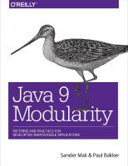
Java Modules General
Very interesting read (you’ll learn a lot more about modules than with this OCP exam):
Java 9 Modularity, O’Reilly, by Sander Mak and Paul Bakker

Slide 41
Links
Example code and presentation
Presentation and Demo OCP CH17
https://p-bitbucket.nl.eu.abnamro.com:7999/projects/COESD/repos/java-triangle/browse/ocp/chapter17
Demo Modules and Injection
https://p-bitbucket.nl.eu.abnamro.com:7999/projects/COESD/repos/java-triangle/browse/modules-and-injection

Slide 42
Done
Questions?

